Slide 1
Iterative Multiplication
Engineering 304 Lab

Slide 2
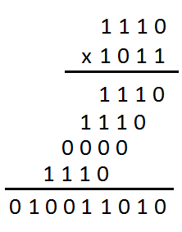
Long-Hand Multiplication
Mulitplicand = 0b1110
Multiplier = 0b1011
14*11 = 154
0b1110*0b1011
= 0b010011010 = 128+16+8+2

Slide 3
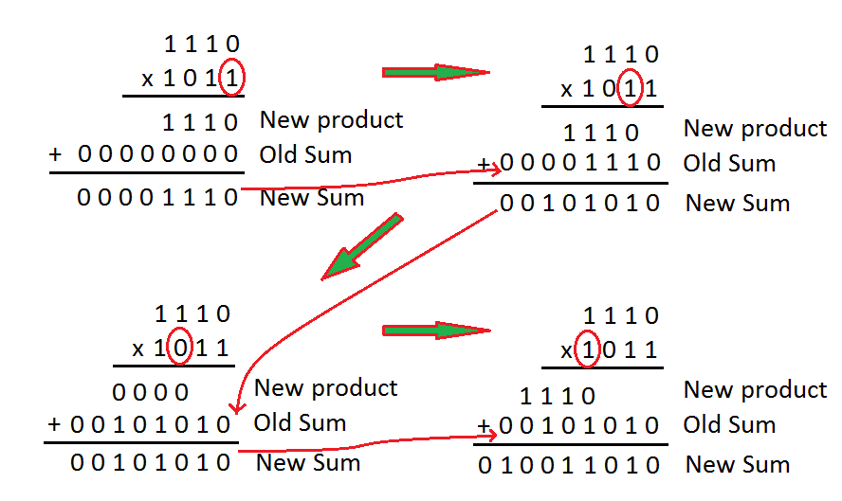

Slide 4
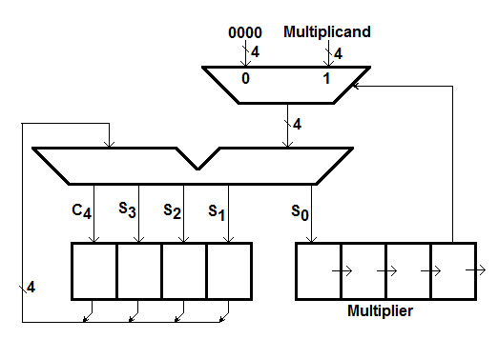
M
Q
A

Slide 5
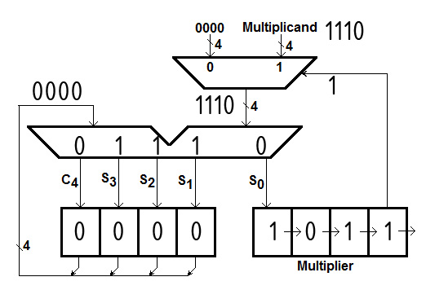
Initial Values Circled
M
Multiplier bits in the green box
Q
A
Notes:
Show the multiplication of 1110 ad 1011 on the board.

Slide 6
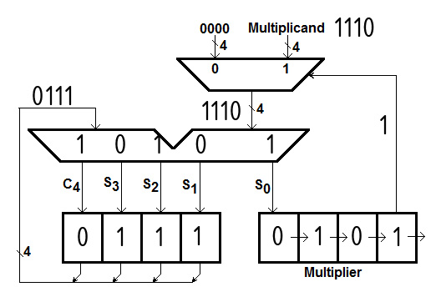
Partial Product Circled
M
Q
A

Slide 7
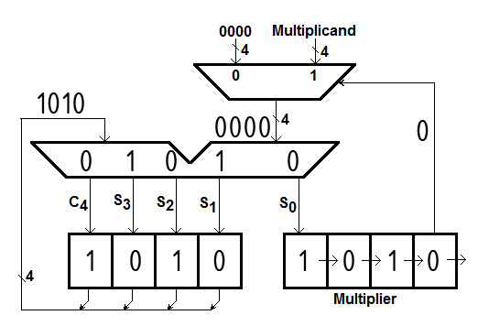
Partial Product Circled
M
Q
A

Slide 8
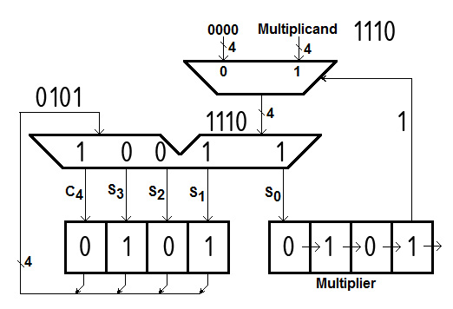
Partial Product Circled
M
Q
A

Slide 9
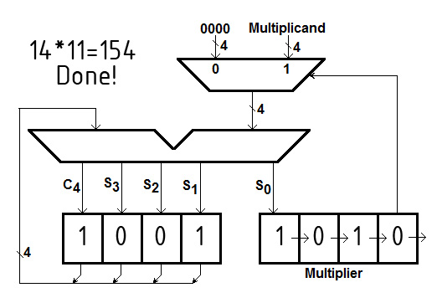
Final Answer Circled
M
Q
A

